Slide 1
Introduction
Many times it is necessary to connect a local area network to another local area network or to a wide area network.
Local area network to local area network connections are often performed with a bridge.
Local area network to wide area network connections are usually performed with a router.
A third device, the switch, can be used to interconnect segments of a local area network.

Slide 2
Why Interconnect?
To separate / connect one corporate division with another.
To connect two LANs with different protocols.
To connect a LAN to the Internet.
To break a LAN into segments to relieve traffic congestion.
To provide a security wall between two different types of users.
To connect WLAN to LAN

Slide 3
Internetworking devices
Descending in increasing power and complexity
Hubs
Bridges
Switches
Routers

Slide 4
Hubs
As seen earlier, a hub interconnects two or more workstations into a local area network. A simple interconnecting device that requires no overhead to operate.
When a workstation transmits to a hub, the hub immediately resends the data frame out all connecting links.
A hub can be managed or unmanaged. A managed hub possesses enough processing power that it can be managed from a remote location.
Hubs continue to become smarter.
Some call any interconnection device in a LAN a hub!

Slide 5
Hubs
Hubs, also called concentrators, expand one Ethernet connection into many. For example, a four-port hub connects up to four machines (or other network devices) via UTP cables. The hub provides a star connection for the four ports. Many hubs contain a single BNC connector as well to connect the hub to existing 10Base-2 network wiring. The hub also can be connected via one of its ports. One port is designed to operate in either Straight-Through or Crossover mode, selected by a switch on the hub.
A hub is similar to a repeater, except it broadcasts data received by any port to all other ports on the hub. Most hubs contain a small amount of intelligence as well, examining received packets and checking them for integrity. If a bad packet arrives or the hub determines that a port is unreliable, it will shut down the line until the error condition disappears. Because of its slight delay when processing a packet, the number of hubs that may be connected in series is also limited. Several hubs can be used to connect five Ethernet segments within the accepted limits. Because each UTP cable may be as long as 100 m, the maximum distance between nodes is 500 m (the network diameter).

Slide 6
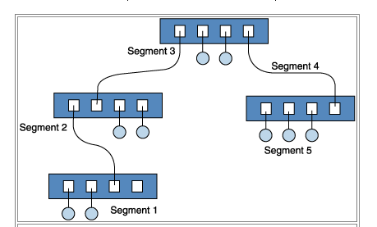
Hubs connecting segments

Slide 7
Bridges
A bridge can be used to connect two similar LANs, such as two CSMA/CD LANs.
A bridge can also be used to connect two closely similar LANs, such as a CSMA/CD LAN and a token ring LAN.
The bridge examines the destination address in a frame and either forwards this frame onto the next LAN or does not.
The bridge examines the source address in a frame and places this address in a routing table, to be used for future routing decisions.

Slide 8
Bridges vs Routers
Bridge: A bridge is a device that connects two segments of the same network. The two networks being connected can be alike or dissimilar. Unlike routers, bridges are protocol-independent. They simply forward packets without analyzing and re-routing messages.
Router: A router is a device that connects two distinct networks. Routers are similar to bridges, but provide additional functionality, such as the ability to filter messages and forward them to different places based on various criteria. The Internet uses routers extensively to forward packets from one host to another.
Based on these definitions we can see that key difference between a bridge and router is that a bridge does not look at protocols and a router does. A bridge does not look at traffic for the purpose of allowing or disallowing it, and it does not decide what to do with certain types of traffic; it simply moves data from one network to another. Whereas a router examines protocols and decides what to do with each packet based on defined criteria.

Slide 9
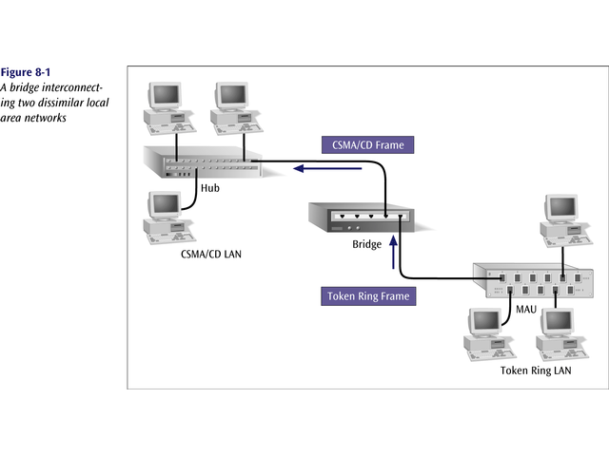
A bridge interconnecting two dissimilar LANs

Slide 10
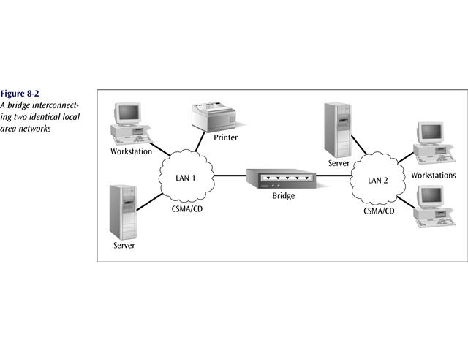
Bridge interconnecting two identical LANs

Slide 11
Transparent Bridges
A transparent bridge does not need programming but observes all traffic and builds routing tables from this observation.
This observation is called backward learning.
Each bridge has two connections (ports) and there is a routing table associated with each port.
A bridge observes each frame that arrives at a port, extracts the source address from the frame, and places that address in the port’s routing table.
A transparent bridge is found with CSMA/CD LANs.

Slide 12
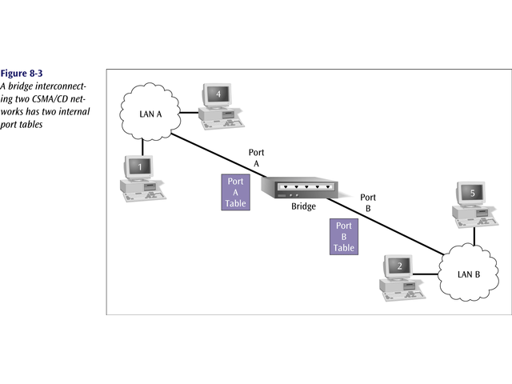
A bridge interconnecting two CSMA/CD networks has
two internal port tables

Slide 13
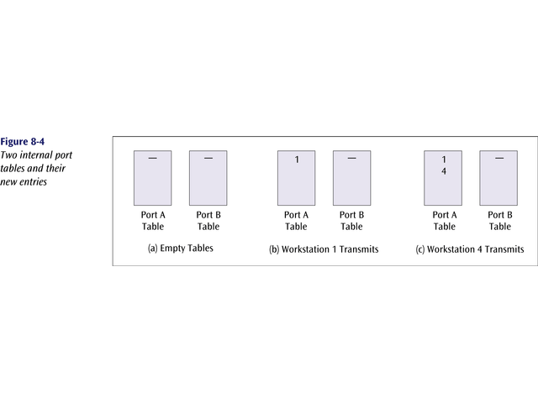
Two internal port tables and their entries

Slide 14
Transparent Bridges
A transparent bridge can also convert one frame format to another.
Note that some people / manufacturers call a bridge such as this a gateway or sometimes a router.
The bridge removes the headers and trailers from one frame format and inserts (encapsulates) the headers and trailers for the second frame format.

Slide 15
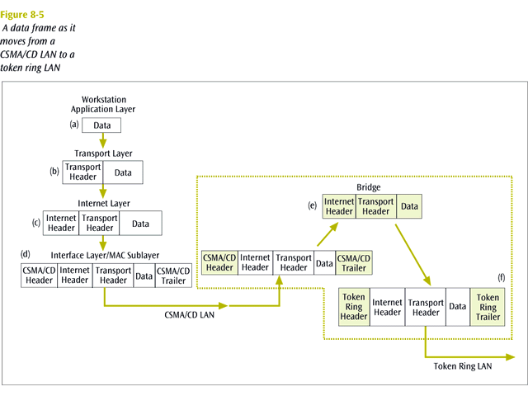
Data Communications and Computer Networks
Chapter 8
Encapsulation

Slide 16
Source-routing Bridges
A source-routing bridge is found with token ring networks.
Source-routing bridges do not learn from watching tables.
When a workstation wants to send a frame, it must know the exact path of network / bridge / network / bridge / network …
If a workstation does not know the exact path, it sends out a discovery frame.
The discovery frame makes its way to the final destination, then as it returns, it records the path.

Slide 17
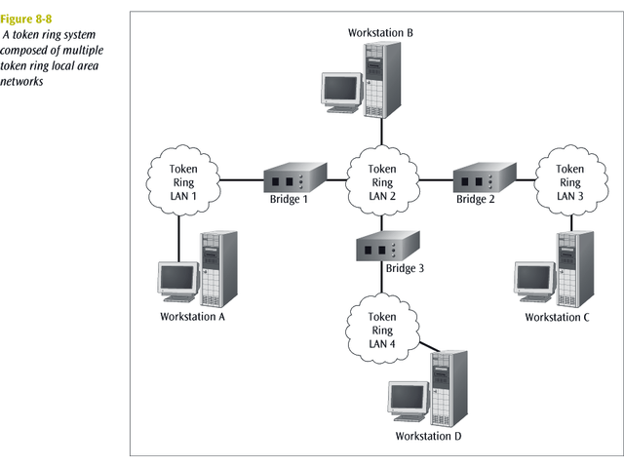
Data Communications and Computer Networks
Chapter 8

Slide 18
Remote Bridges
A remote bridge is capable of passing a data frame from one local area network to another when the two LANs are separated by a long distance and there is a wide area network connecting the two LANs.
A remote bridge takes the frame before it leaves the first LAN and encapsulates the WAN headers and trailers.
When the packet arrives at the destination remote bridge, that bridge removes the WAN headers and trailers leaving the original frame.

Slide 19
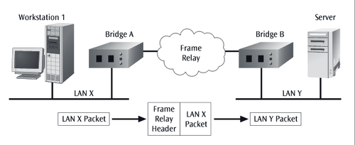
Two LANs with intervening frame relay network

Slide 20
Switches
A switch is a combination of a hub and a bridge.
It can interconnect two or more workstations, but like a bridge, it observes traffic flow and learns.
When a frame arrives at a switch, the switch examines the destination address and forwards the frame out the one necessary connection.
  Workstations that connect to a hub are on a shared segment.
  Workstations that connect to a switch are on a switched segment.

Slide 21
Switches
The backplane of a switch is fast enough to support multiple data transfers at one time.
A switch that employs a cut-through architecture is one that passes on the frame before the entire frame has arrived at the switch.
Multiple workstations connected to a switch use dedicated segments. This is a very efficient way to isolate heavy users from the network.
A switch can allow simultaneous access to multiple servers, or multiple simultaneous connections to a single server.

Slide 22
Switches vs routers
Switches are considered layer-two devices, using MAC addresses to forward frames to their proper destination. Routers, layer-three devices, are much more complex, using microprocessor-based circuitry to route packets between networks based on their IP address. Routers provide the following services: route discovery; selection of the best route to a destination; adaptation to changes in the network; translation from one technology to another, such as Ethernet to token ring; packet filtering based on IP address, protocol, or UDP/TCP port number; and connection to a WAN.
Because of the additional processing required for each packet, a router has a higher latency than a switch. In addition, a router requires an initial set-up sequence, in which the ports are programmed and certain protocols and characteristics are enabled or disabled. A switch may be simply plugged into the network, automatically learning how to forward frames as the network is used. Note that some protocols (e.g., NetBEUI) can’t be routed; instead, they will pass through a switch. Finally, switches are used within networks to forward local traffic intelligently. Routers are used between networks to route packets between networks in the most efficient manner.

Slide 23
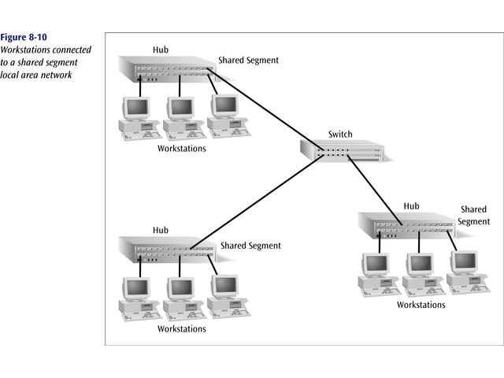
Workstations connected to a shared segment of a LAN

Slide 24
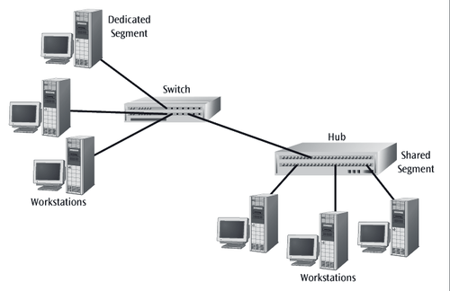
Workstations connected to a dedicated segment of a LAN

Slide 25
Data Communications and Computer Networks
Chapter 8
Switches
Major role: isolating traffic patterns and providing multiple access. This design is usually done by the network manager.
Switches are easy to install and have components that are hot-swappable.

Slide 26
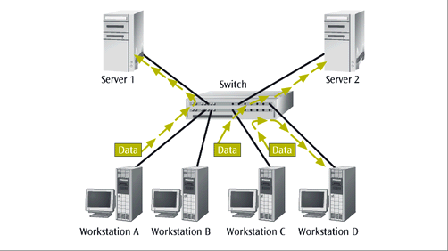
A Switch with Two Servers Allowing Simultaneous Access to
Each Server

Slide 27
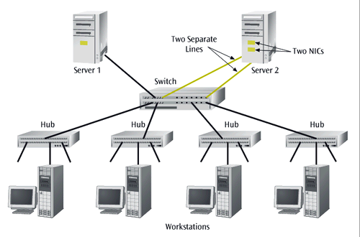
A server with two NICs and two connections to a switch

Slide 28
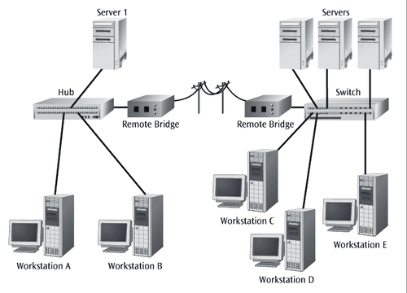
A pair of remote bridges and switch combination
designed to isolate network traffic

Slide 29
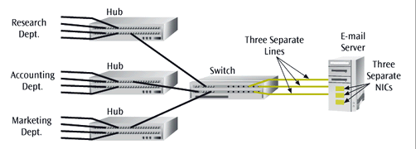
Switch providing multiple access to an e-mail server

Slide 30
Full Duplex Switches
A full duplex switch allows for simultaneous transmission and reception of data to and from a workstation.
  Problem with ethernet – half duplex.
This full duplex connection helps to eliminate collisions.
To support a full duplex connection to a switch, two sets of wires are necessary - one for the receive operation and one for the transmit operation.

Slide 31
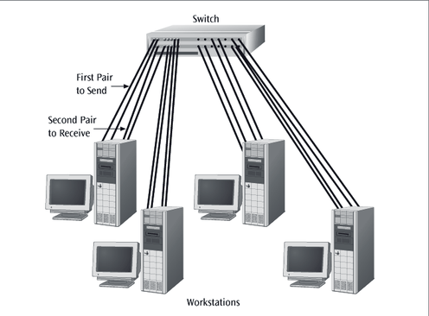
Full duplex connection of workstations to a LAN switch

Slide 32
Network Servers
Network servers provide the storage necessary for LAN software.
They are usually the focal point for the network operating system.
Increasingly, network servers are functioning as bridges, switches, and routers. By adding the appropriate card, a server can assume multiple functions.

Slide 33
Routers (really specialized computers)
The device that connects a LAN to a WAN or a WAN to a WAN (the INTERNET! – uses IP addresses).
A router accepts an outgoing packet, removes any LAN headers and trailers, and encapsulates the necessary WAN headers and trailers.
Because a router has to make wide area network routing decisions, the router has to dig down into the network layer of the packet to retrieve the network destination address.

Slide 34
Routers
Thus, routers are often called “layer 3 devices”. They operate at the third layer, or OSI network layer, of the packet.
Routers often incorporate firewall functions.
An example of a router’s operation is shown on the next slide.

Slide 35
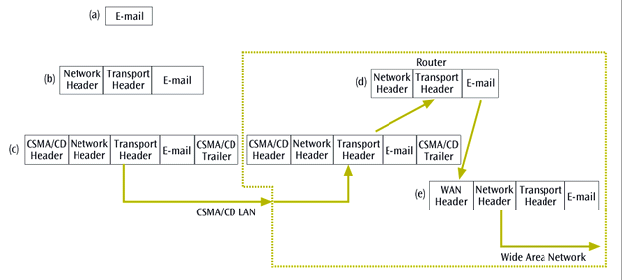
Router conversion of CSMA/CD data frame to an internet
frame as it passes from a LAN to the internet

Slide 36
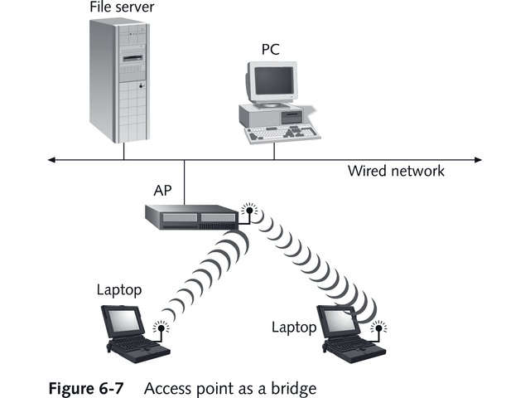
Wireless connections: Access Point as a Bridge

Slide 37
Connections (in general)
Bridges for LANs and hubs.
Switches for LANs and workstations.
Routers for LANs and WANs (the Internet).

Slide 38
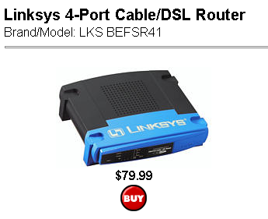
Linksys Router for Home Network

Slide 39
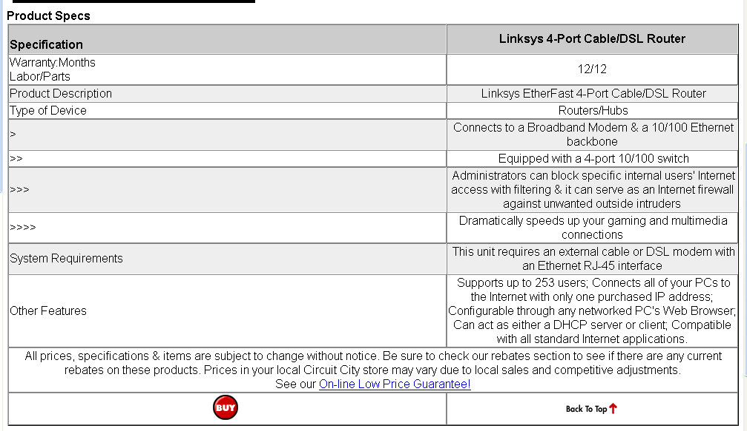
Linksys Router for Home Network

Slide 40
The OSI Reference Model
Application
Layer
Application
Layer
Presentation
Layer
Presentation
Layer
Session
Layer
Session
Layer
Transport
Layer
Transport
Layer
Network
Layer
Network
Layer
Data Link
Layer
Data Link
Layer
Physical
Layer
Physical
Layer
Notes:
03/11/98
6
Chapter 12 - Network Interconnections

Slide 41
The Physical Layer Connection
Application
Layer
Application
Layer
Presentation
Layer
Presentation
Layer
Session
Layer
Session
Layer
Transport
Layer
Transport
Layer
Network
Layer
Specifies electrical connection
Network
Layer
Data Link
Layer
Data Link
Layer
Physical
Layer
Physical
Layer
Notes:
03/11/98
7
Chapter 12 - Network Interconnections

Slide 42
The Physical Layer Connection
Application
Layer
Application
Layer
Presentation
Layer
Presentation
Layer
Session
Layer
Session
Layer
Transport
Layer
Transport
Layer
Network
Layer
Network
Layer
Amplification
Regeneration
Data Link
Layer
Data Link
Layer
Physical
Layer
Hub
Physical
Layer
Notes:
03/11/98
8
Chapter 12 - Network Interconnections

Slide 43
The Data Link Connection
Application
Layer
Application
Layer
Presentation
Layer
Presentation
Layer
Session
Layer
Session
Layer
Delineation
of
Data
Error
Detection
Transport
Layer
Address
Formatting
Transport
Layer
Network
Layer
Network
Layer
Data Link
Layer
Data Link
Layer
Physical
Layer
Physical
Layer
Notes:
03/11/98
9
Chapter 12 - Network Interconnections

Slide 44
The Data Link Connection
Application
Layer
Application
Layer
Presentation
Layer
Presentation
Layer
Session
Layer
Session
Layer
Transport
Layer
Transport
Layer
Network
Layer
Network
Layer
Data Link
Layer
Bridge
& Switch
Data Link
Layer
Physical
Layer
Physical
Layer
Notes:
03/11/98
10
Chapter 12 - Network Interconnections

Slide 45
The Network Layer Connection
Application
Layer
Application
Layer
Presentation
Layer
Presentation
Layer
Session
Layer
Session
Layer
Transport
Layer
End to end routing
Transport
Layer
Network
Layer
Network
Layer
Data Link
Layer
Data Link
Layer
Physical
Layer
Physical
Layer
Notes:
03/11/98
13
Chapter 12 - Network Interconnections

Slide 46
The Network Layer Connection
Application
Layer
Application
Layer
Presentation
Layer
Presentation
Layer
Session
Layer
Session
Layer
Transport
Layer
Transport
Layer
Network
Layer
Router
Network
Layer
Data Link
Layer
Data Link
Layer
Physical
Layer
Physical
Layer
Notes:
03/11/98
14
Chapter 12 - Network Interconnections

Slide 47
Data Communications and Computer Networks
Chapter 8
QoS (Quality of Service):
Concept that data transmission rates, error rates, and other network characteristics can be measured, improved and guaranteed in advance. Routers play an important role in this business and engineering concept.

Slide 48
Data Communications and Computer Networks
Chapter 8
LAN Internetworking In Action: A Small Office Revisited
Recall the In Action example from Chapter Seven.
A small office with 20 workstations in one room and 15 workstations in another room were connected to a server via 100BaseTX.
One hub was kept in a closet near the 20 workstations while a second hub was near the server.

Slide 49
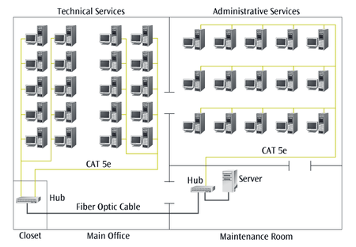
Hannah’s earlier small business solution

Slide 50
Data Communications and Computer Networks
Chapter 8
LAN Internetworking In Action: A Small Office Revisited
Now Hannah wants to connect the LAN to the Internet.
She adds a router next to the server and connects it to the hub.
She connects the router to a high-speed telephone line such as a T-1 service.
She will also have to program the router to perform IP addressing and firewall functions.

Slide 51
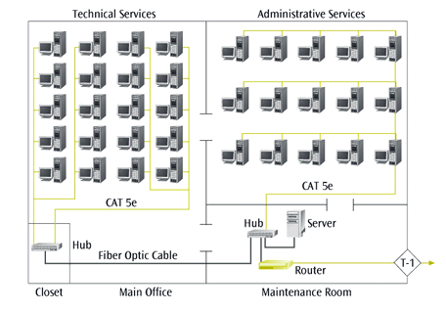
The modified network with a router and high-speed
phone line

Slide 52
Data Communications and Computer Networks
Chapter 8
LAN Internetworking In Action: A Small Office Revisited
Now network usage is so high that Hannah must consider segmenting the network.
She decides to install a database server near the original server and replace both hubs with switches.

Slide 53
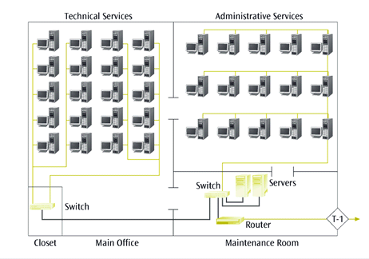
Upgraded network with additional server and switches
in the place of hubs

